Slide 1
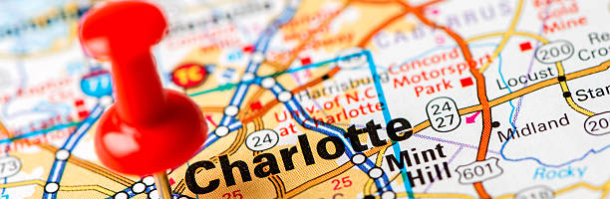
Crime Analysis
Charlotte, North Carolina
Angelique N Joshua M Brianna B Nicoletta Sheppard
TEAM GRYFFINDOR

Slide 2
Intro
Predictive Policing
make better decisions
target resources
formulate strategies
tactical analysis (e.g. crime forecasting, geographic profiling).
Community Usage
Raise awareness
Safe neighborhoods
Notes:
Crime analysis is used to understand patterns of incarceration and recidivism, help target resources and programs, evaluate crime prevention or crime reduction programs, and further understanding of causes of crime.

Slide 3
Data processing & HTML

Slide 4
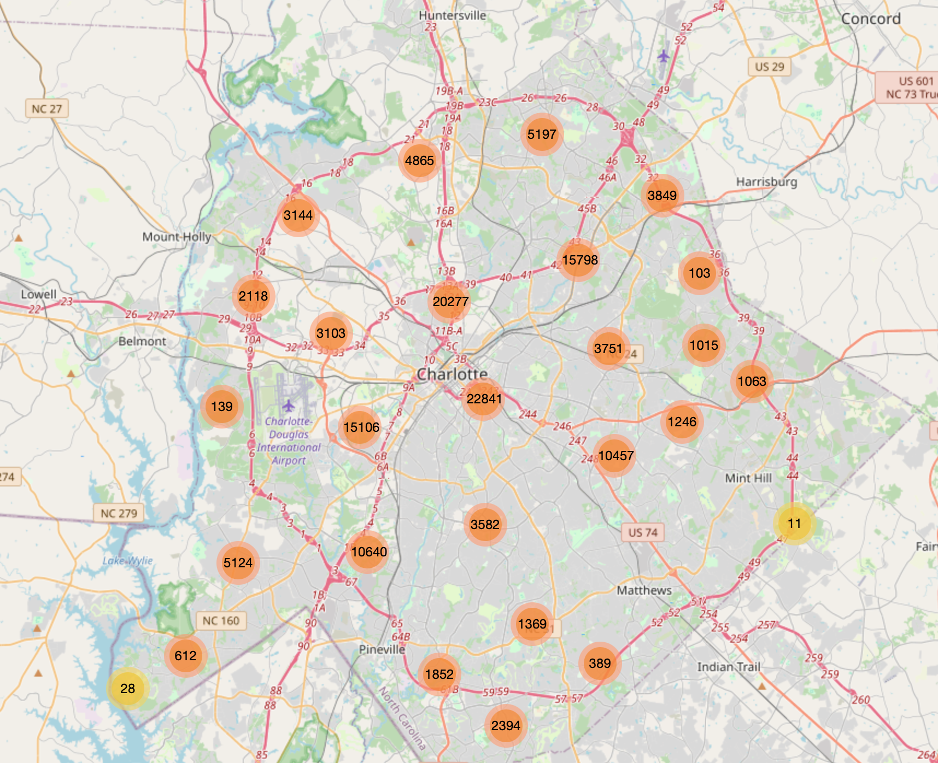
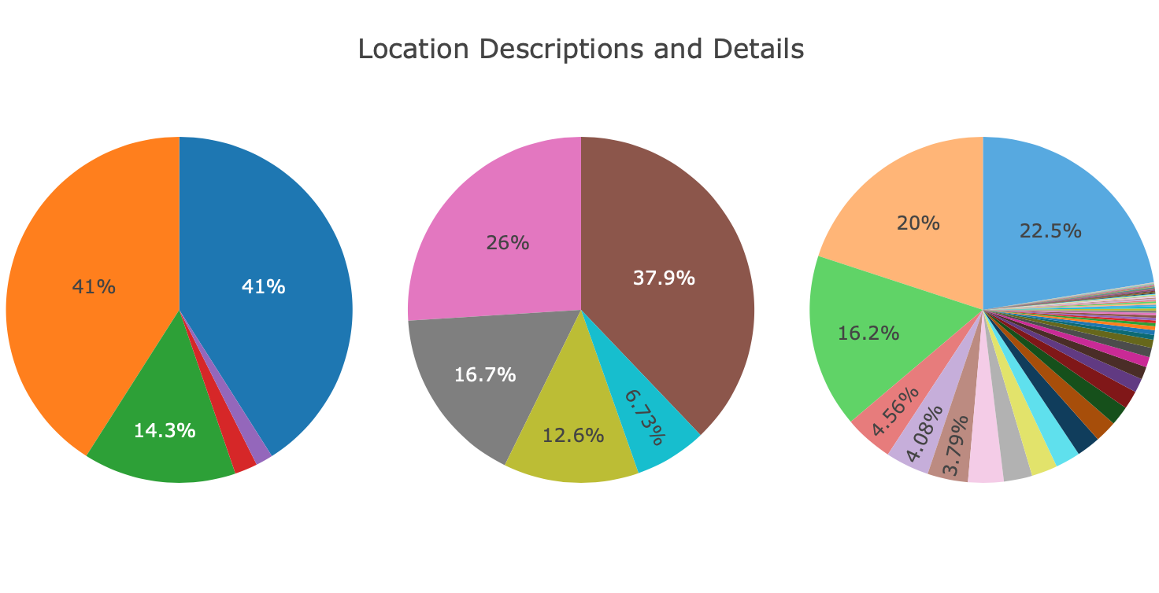
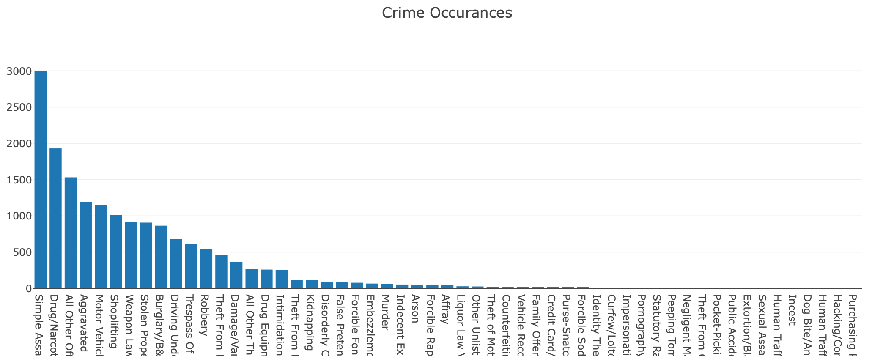
Visuals & Mapping

Slide 5

Conclusion
This Photo by Unknown Author is licensed under CC BY-SA

Slide 6
Work Cited
https://data.charlottenc.gov/datasets/d22200cd879248fcb2258e6840bd6726_0/explore?location=35.261109%2C-80.809400%2C9.97

